Slide 1

Movie Recommendation Chatbot
Enigma

Slide 2
Enigma Team members
Ahmad Akram ibrahim 17P6054
Manar Mohammed Nouh 17P6046
Mohammed Yasser Abdallah 17P6019
Yomna Mohamed 17P6059
Enigma

Slide 3
Chatbot content
Brain
Backend
Score function
Frontend
Enigma

Slide 4
Frontend
Provides an interface for user interaction.
Uses HTML and CSS for the layout and JavaScript for communicating with the backend.
Enigma

Slide 5
Backend
Flask connects the user’s input to the chatbot’s brain.
Gets the chatbot’s response and gets the movie recommendations from the score function.
Enigma

Slide 6
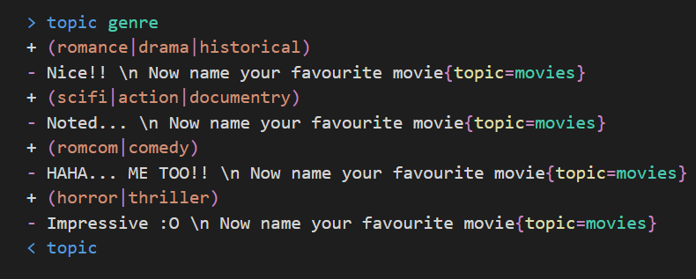
Brain
Uses rive Script to guide the chatbot how to respond to different input texts.
Contains different language topics
Enigma

Slide 7
Score function
Contains two datasets (movies’ titles and ratings).
Uses the user’s input sent by the chatbot’s brain to calculate the similarities between the sent movie and the datasets (considering the genres and the ratings).
Enigma

Slide 8
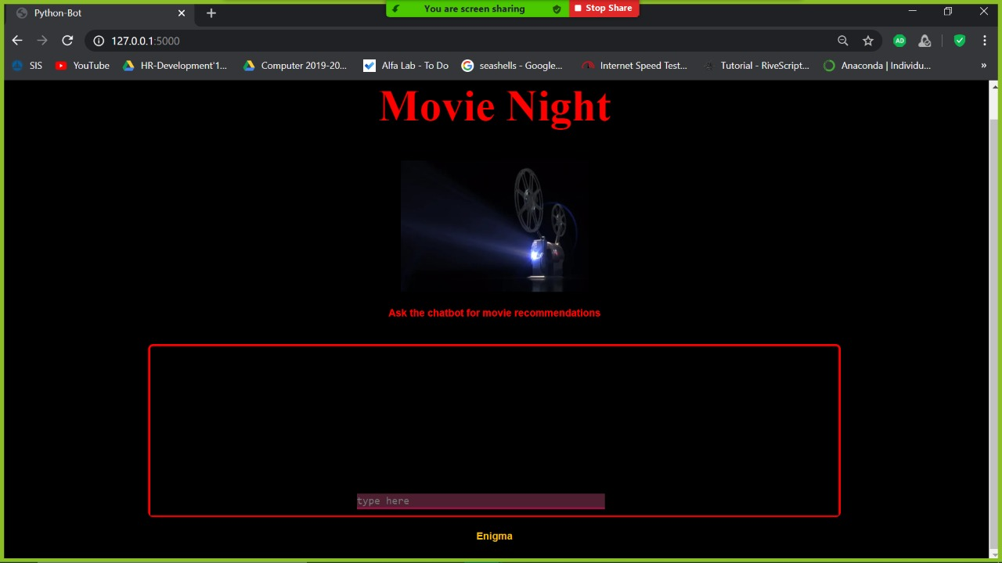
Screenshots of the chatbot
Enigma

Slide 9
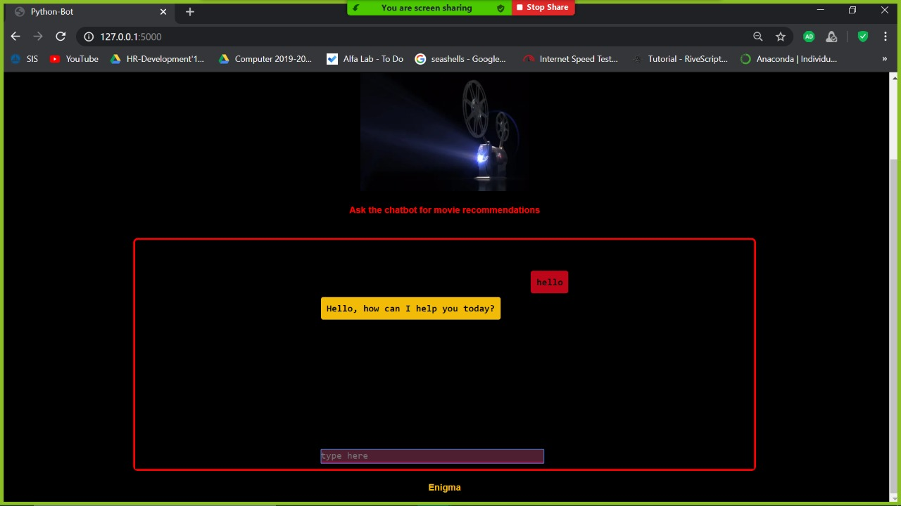
Enigma

Slide 10
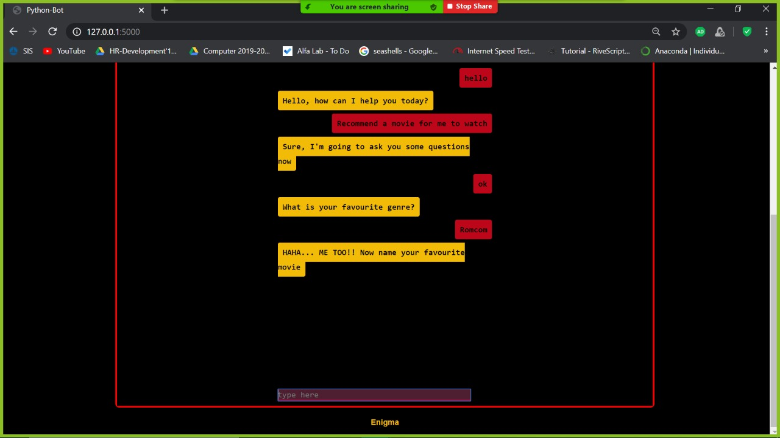
Enigma

Slide 11
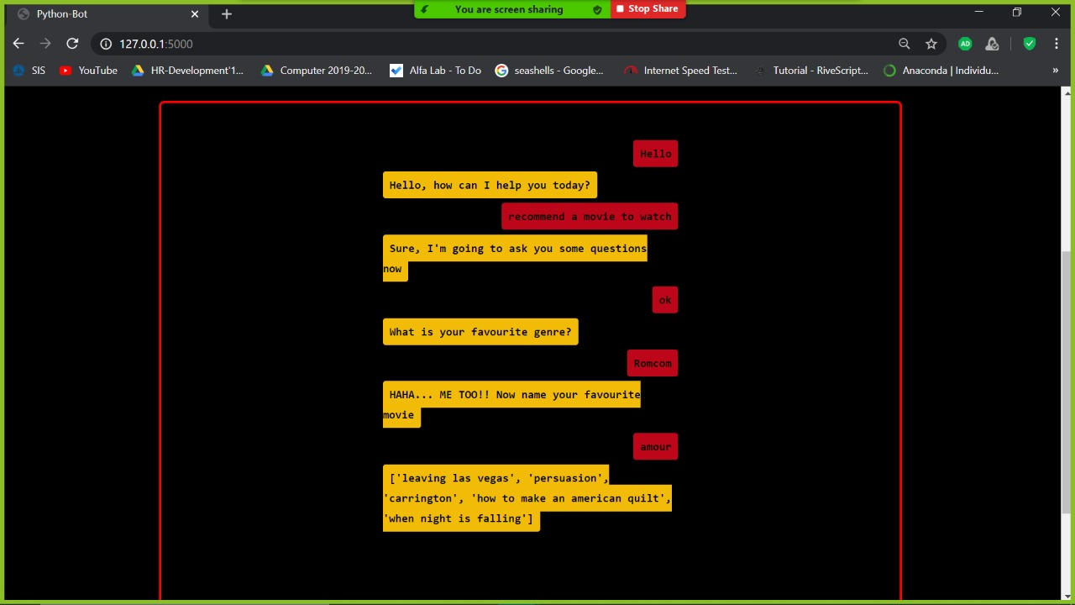
Enigma

